Slide 1
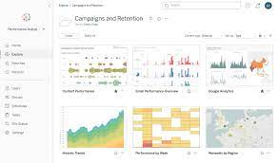
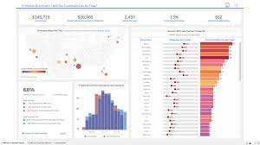
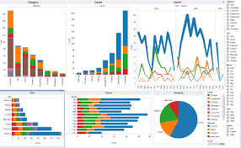
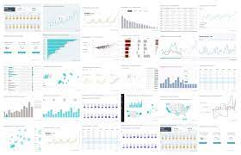

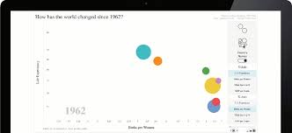
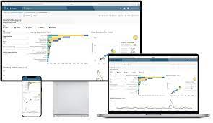
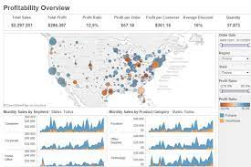
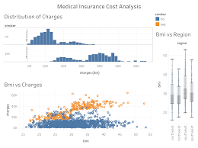

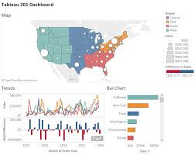
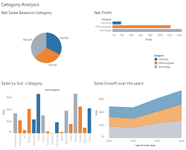
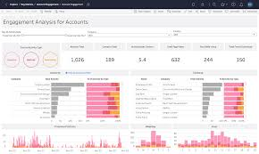
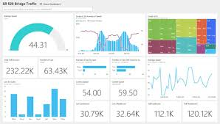

Slide 2

Tableau is a visual analytics platform transforming the way we use data to solve problems—empowering people and organizations to make the most of their data.

Slide 7
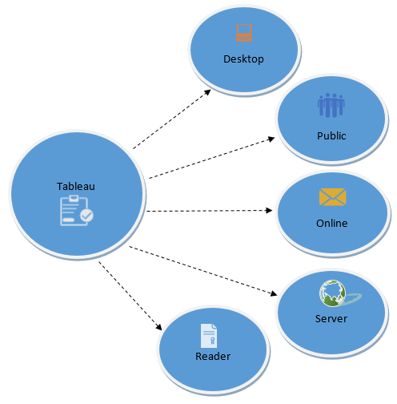

Slide 8
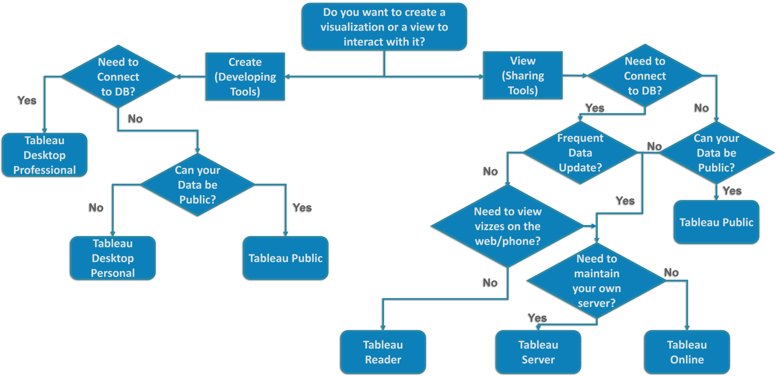

Slide 9
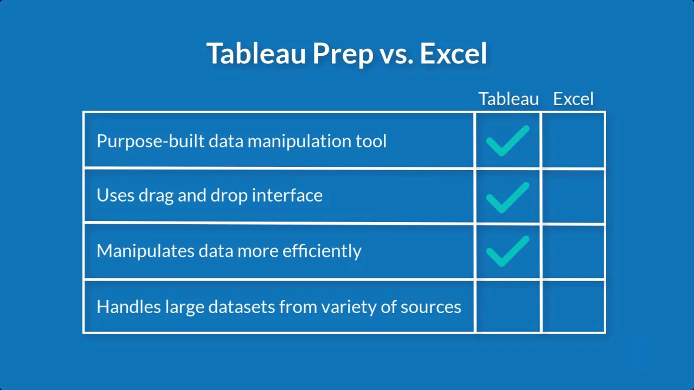
R

Slide 12
Project: Forecasting Your sales
Tasks to Do:
Show the Line graph to represent the Trend of your Sales over a period of time.
Forecast your Sales for the future.

Slide 13
Project: Add Data to Dashboard
Add data to the dashboard by using sheets. You can adjust the size and alignment as per your choice.

Slide 14
Project
Make Story by adding Entry Points from various Sheets.

Slide 16
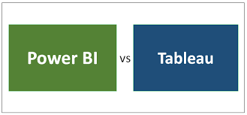
R

Slide 17
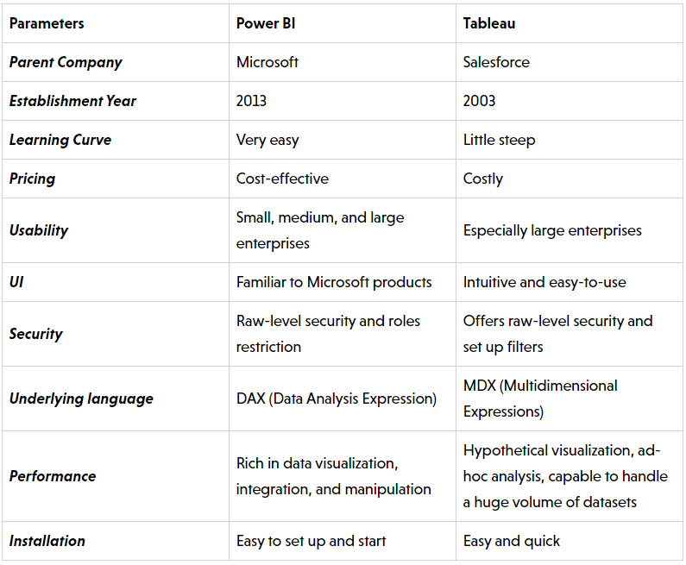

Slide 18
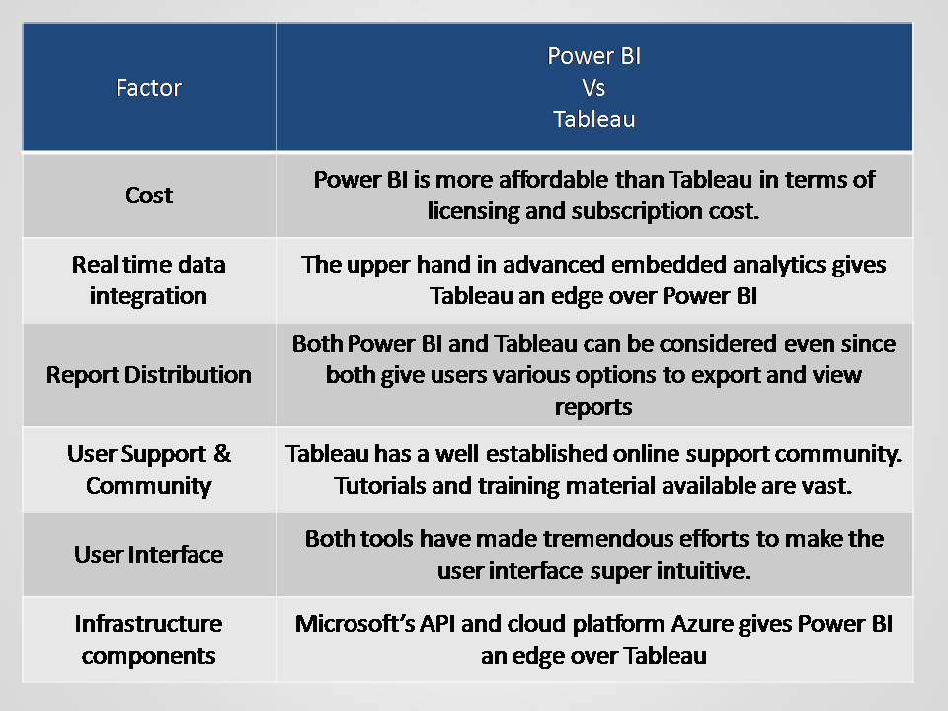

Slide 19
Quiz
Create a calculated field named Total Revenue that should have sum of ‘Male revenue’ and ‘Female revenue’.

Slide 20
Quiz
Create a calculated field named Age in bins and make bins equal to 20. Make sure to represent data as discrete values.

Slide 21
Quiz
Create a calculated field that should have the sum of age.

